Slide 1
Team 8 – IrishWrecksOnline.net
Coming to the 21st Century

Slide 2

Members
Tracey Olson
Mehran Nejad
Gregor Hnckley

Slide 3
Why did we do it?
We really thought we could improve the page for more modern look.
Make it easier to use.
Easy to read
Something everybody of any experience can us.
Fun and informative

Slide 4
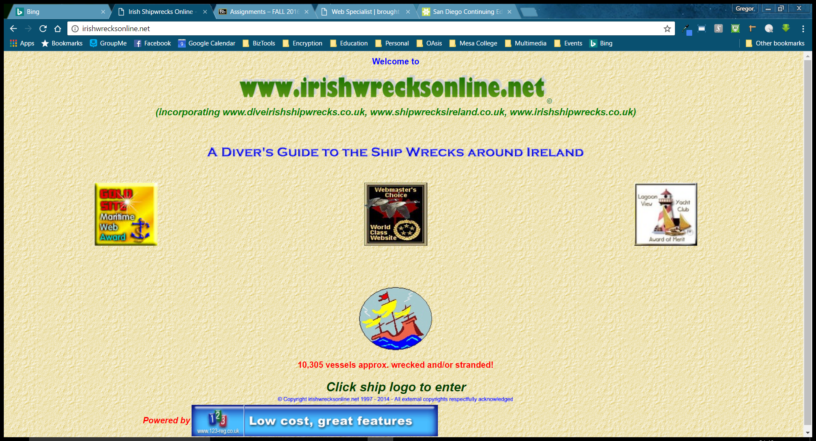
IrishWrecksOnline.net
The original page was a little dated:
Originally written in 1998 the page had a limited interface.
The site focuses on accessing a database of ship wrecks around Ireland.
Th user interface was a little shacky – You had to click on an icon to get to the information

Slide 5
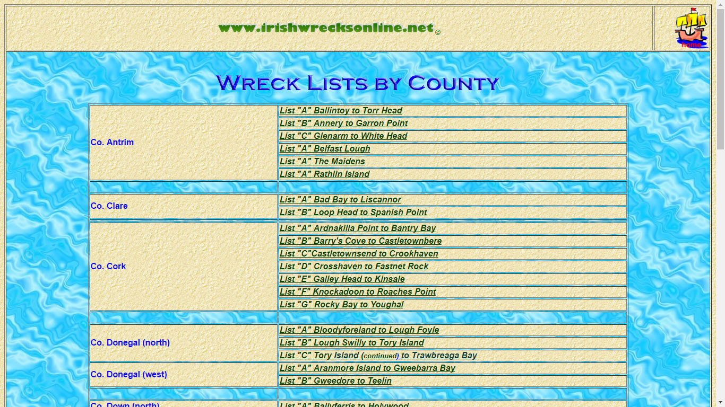
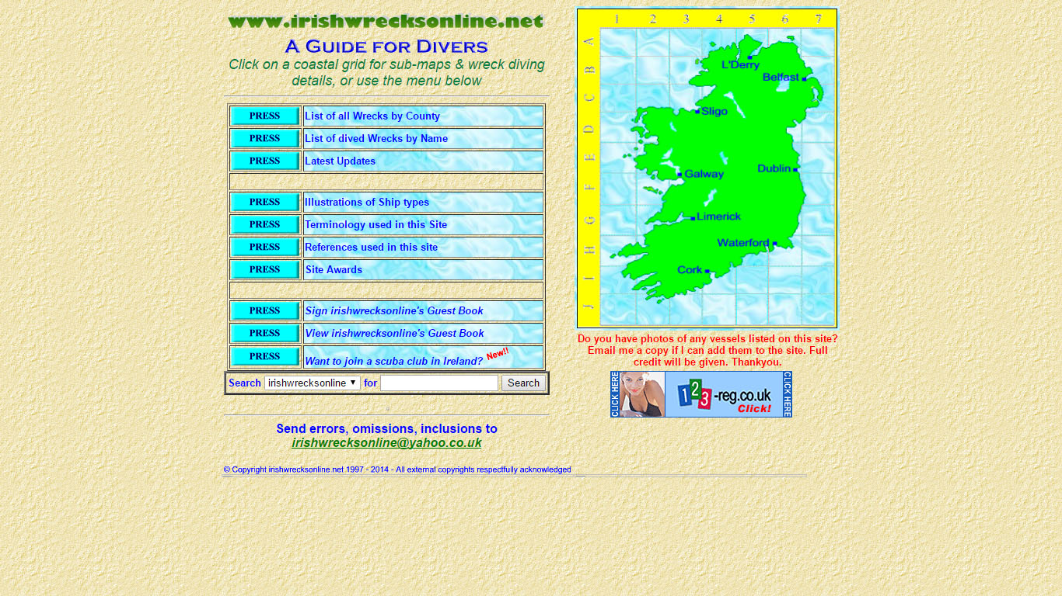
Users had to work for it.
You did have an interactive map to click. But is you did not know Ireland it was pretty limited
Local Knowledge was important.
Unattractive
Tabular layout all over the place.
Ancient School.

Slide 6
Who would use it?
We felt several different types of people might use it.
Scholars
Vacationers
Students

Slide 7
Persona
Nthaba Ngalo
History Professor University of Durban
Homiest Diver but is looking in to family history
Nthaba Ngalo
History Professor University of Durban
Homiest Diver but is looking in to family history
Jackson McCleary
IT Manager In Dalas Tx
Researching his Family history
Orla Murphy
Student PhD in Earth and Ocean sciences
Diving since she was a child she has a passion for the ocean.
Ntahba
Jackson
Orla

Slide 8
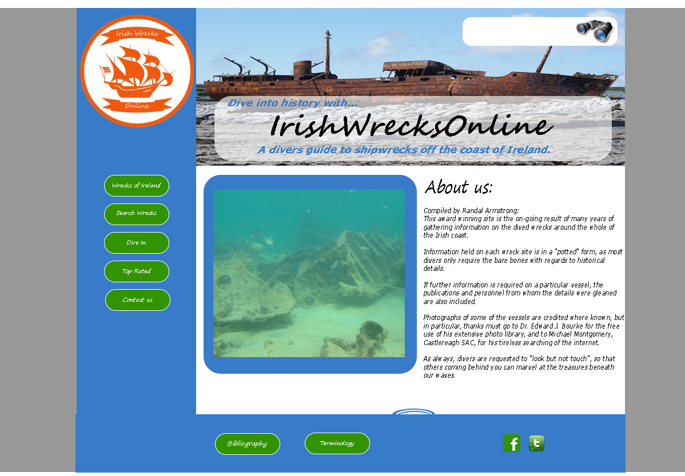
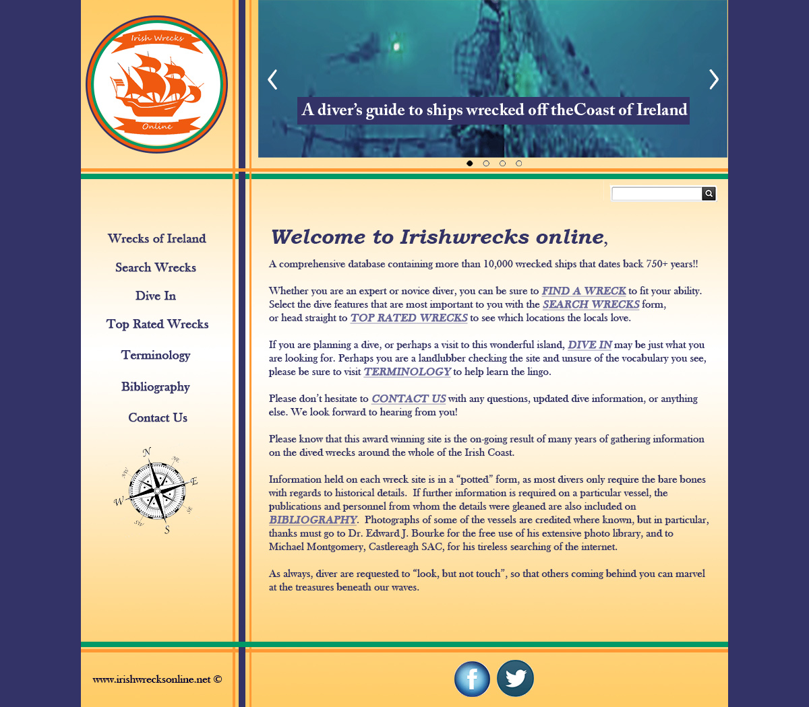
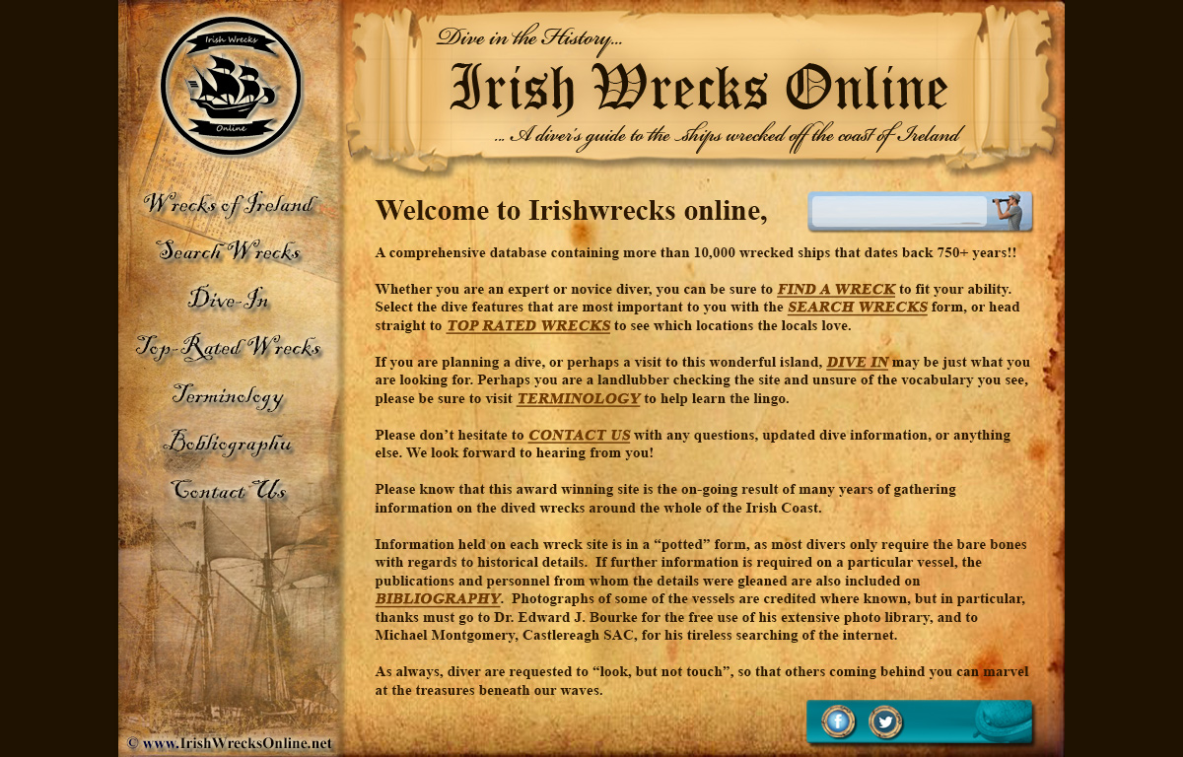
Different Visions to made it better

Slide 9
Getting the data – Card Sort

Slide 10
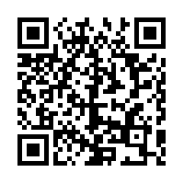
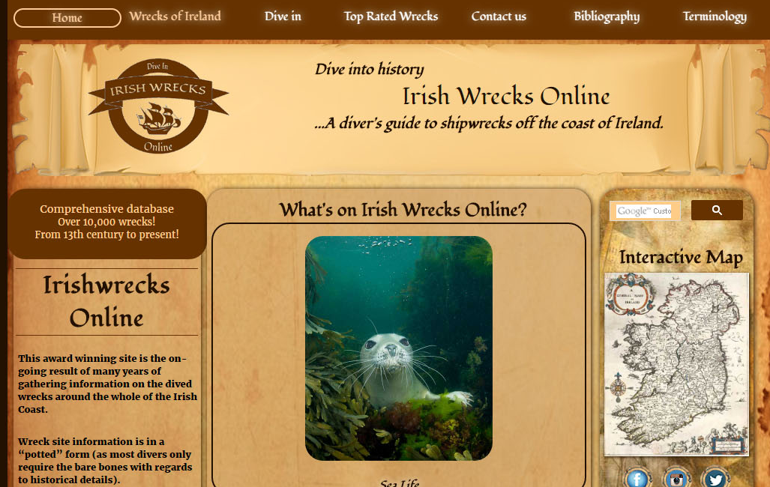
So go live a little history

